Slide 1

Stroke Prevention Calculator
Brandon Lee, Michelle Naclerio, Ariel Fitzgerald, Parker Mills, & Hannah Cranford
Brought to you by: https://GoogleSlidesThemes.com
Notes:
Parker

Slide 2

Webpage
https://stroke-prediction-calculator.herokuapp.com/
Notes:
Parker

Slide 3
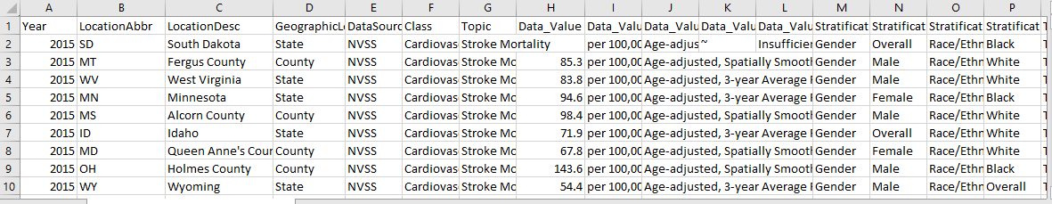
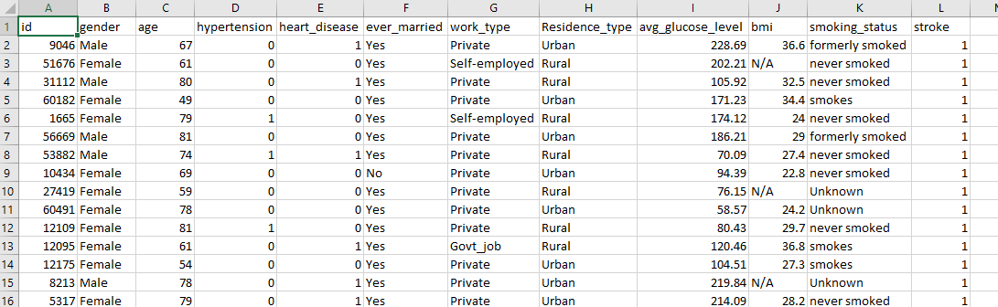
Data
CDC Website
Heart_Disease_Mortality_Data_Among_US..2016-2018.csv
Used for Tableau graph creations
Kaggle.com
healthcare-dataset-stroke-data.csv
Used for Machine Learning
Notes:
Brandon

Slide 4
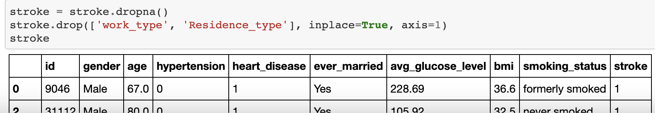
Cleaning
Imported original dataset into jupyter for initial cleaning of our dataset
Removed data with null values to get to 4909 rows for our test population
Notes:
brandon

Slide 5
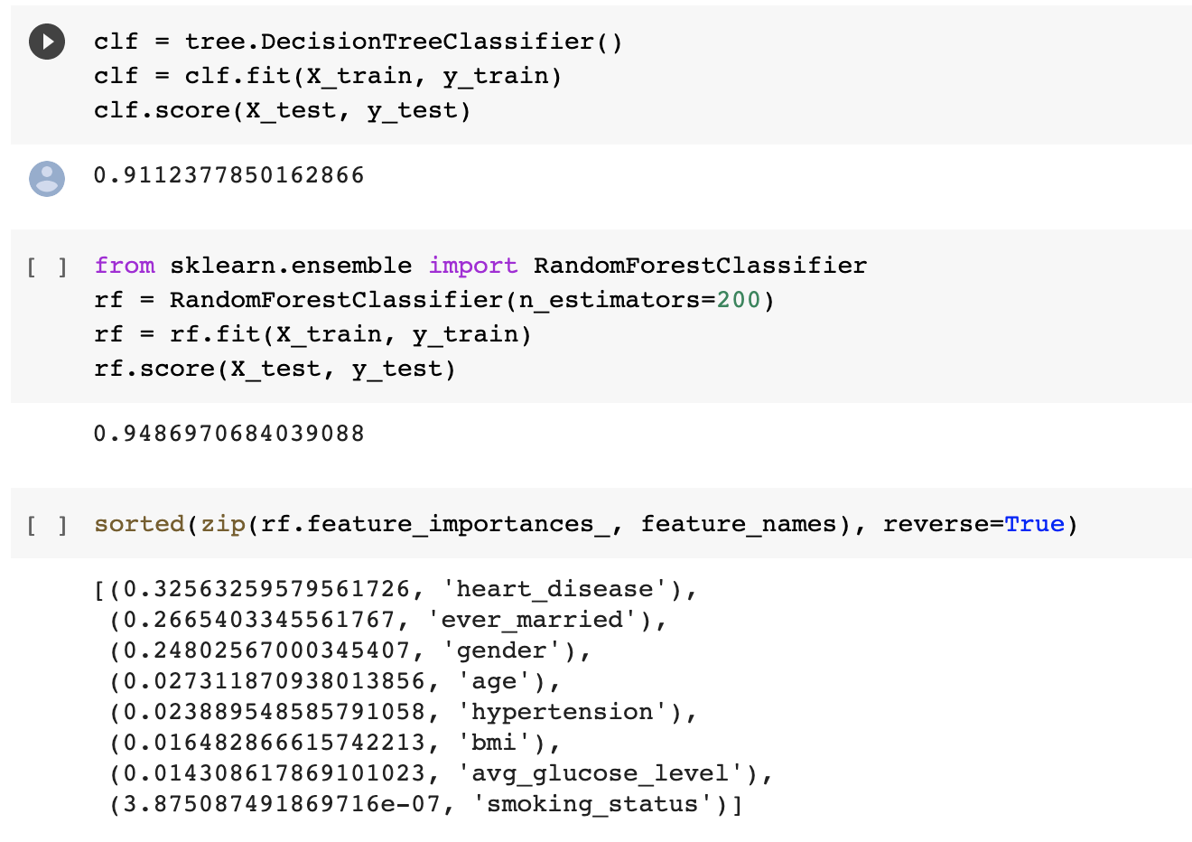
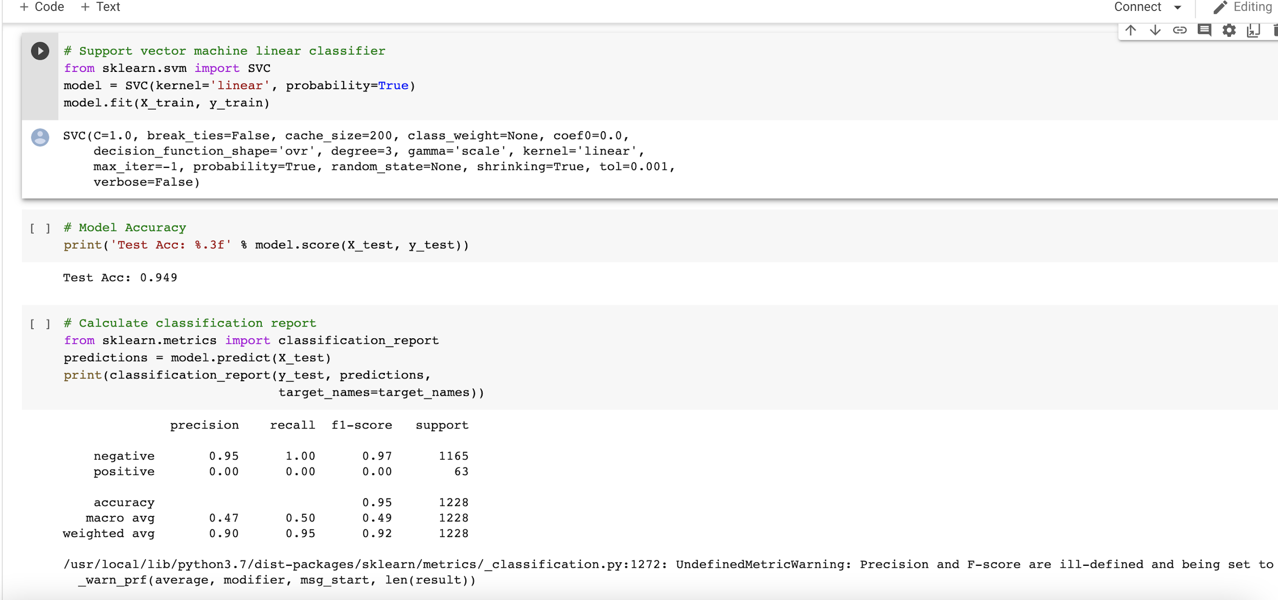
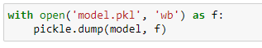
Machine Learning
Random Forest Classifier
Heart disease was biggest factor
smoking status
SVC
0.949 accuracy
Pickle
exports model to .pkl file
use .pkl file in our python script
Notes:
brandon

Slide 6
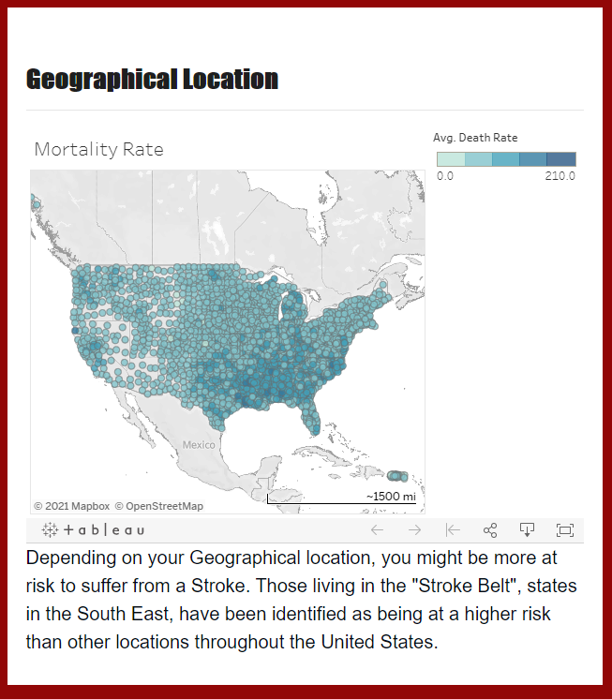
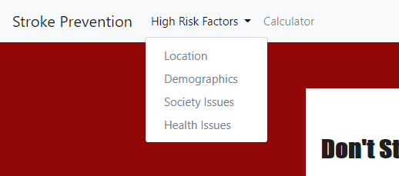
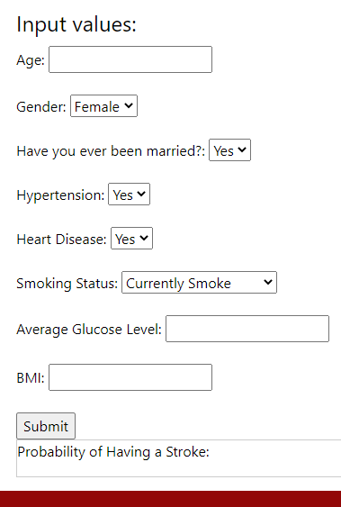

HTML Pages
Risk factor pages contain a visual and a brief write-up of the factor
Calculator contains user form
Buttons and Dropdown selection to other webpages
Notes:
parker

Slide 7
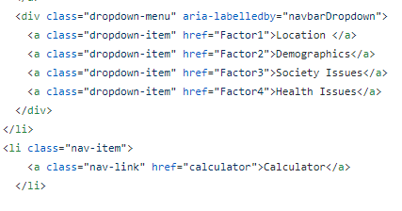
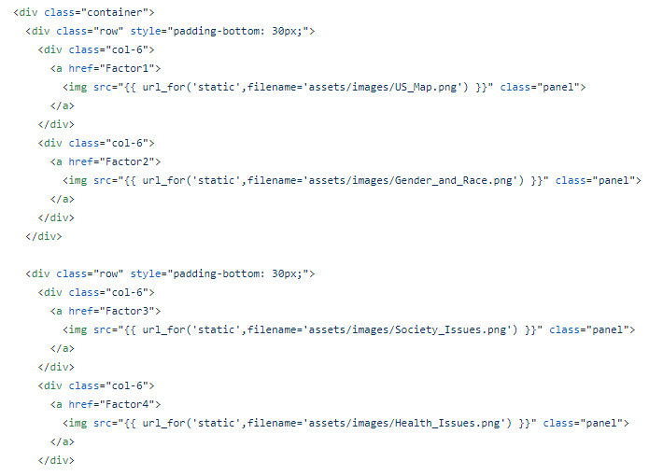
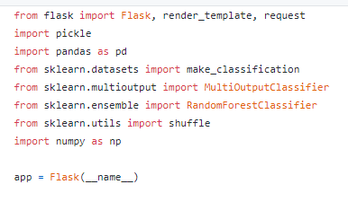
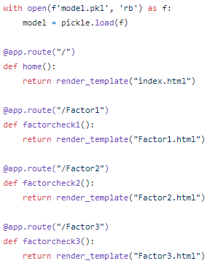
HTML
HTML Pages Code
Created a Flask app to run our webpage
Multiple routes to direct the user to each stroke causing factor html file
Python
Notes:
Michelle

Slide 8
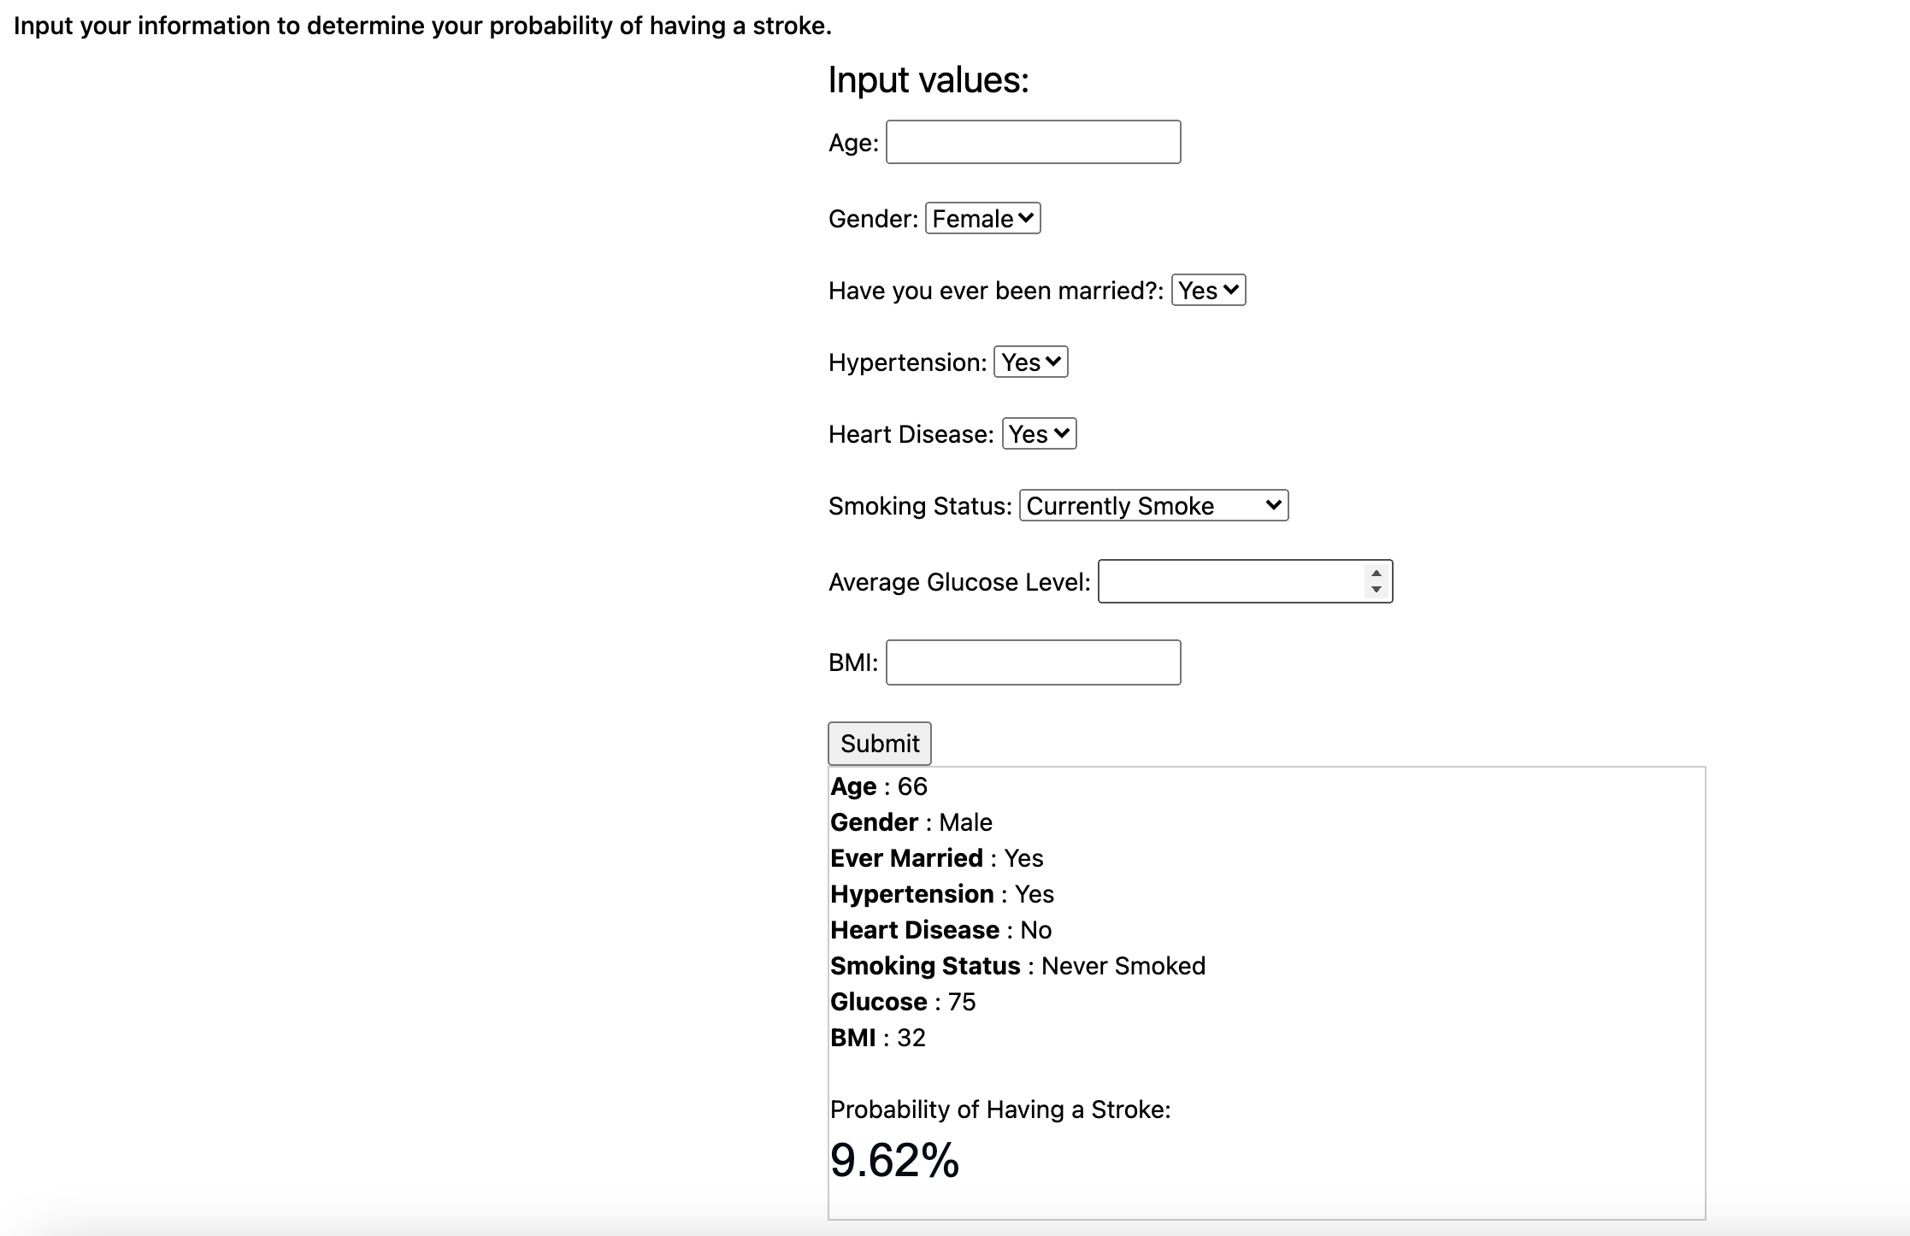
Calculator
User inputs values
Submit form
User inputs displayed
Stroke Probability
Notes:
Ariel

Slide 9
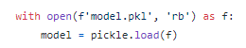
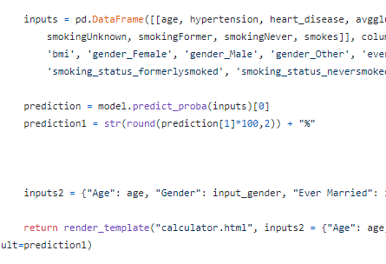
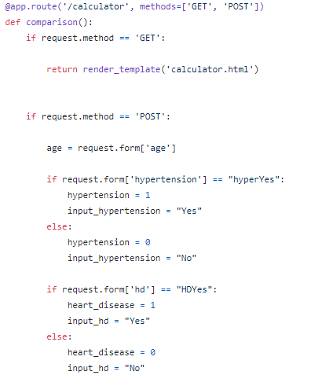
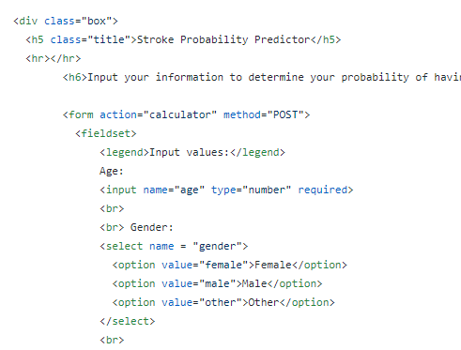
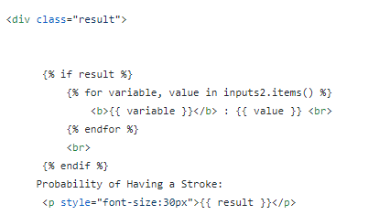
Python
Calculator Code
loaded .pkl model file
[‘Get’,’Post’] method was used to retrieve user selected inputs defined on calculator.html
Predict_proba for our prediction model
Created a dictionary of user’s inputs to call via render_template along with our prediction
HTML
Notes:
Michelle

Slide 10
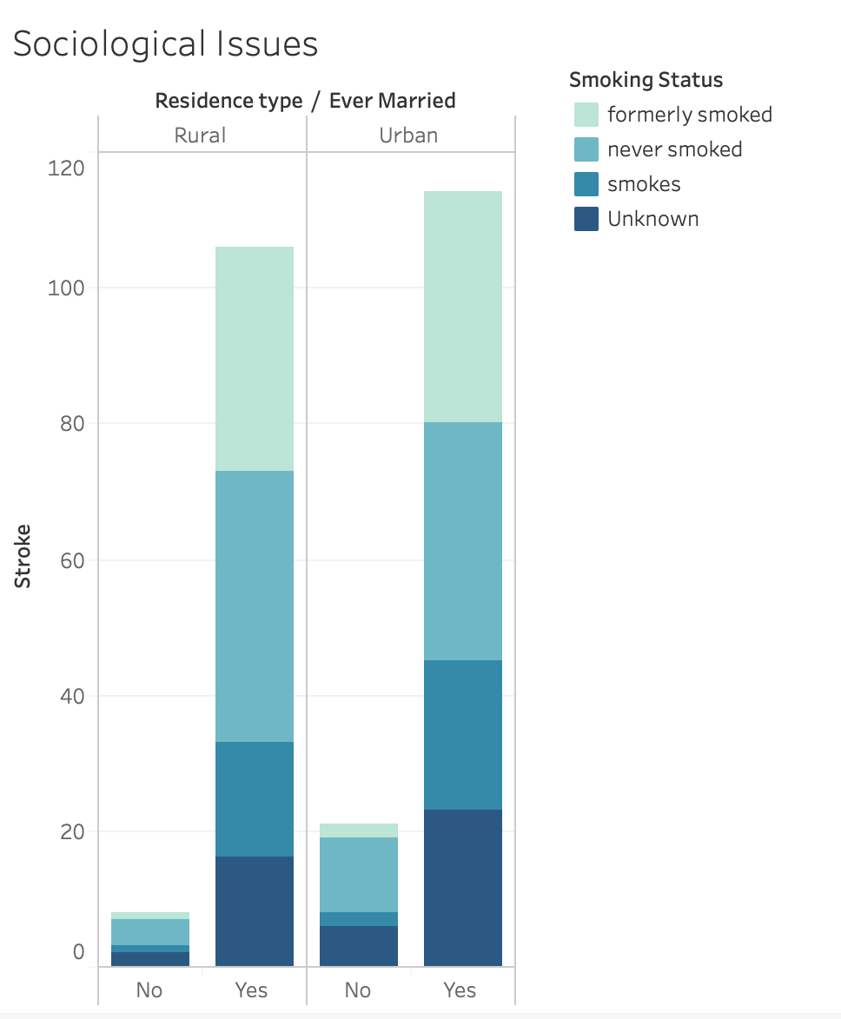
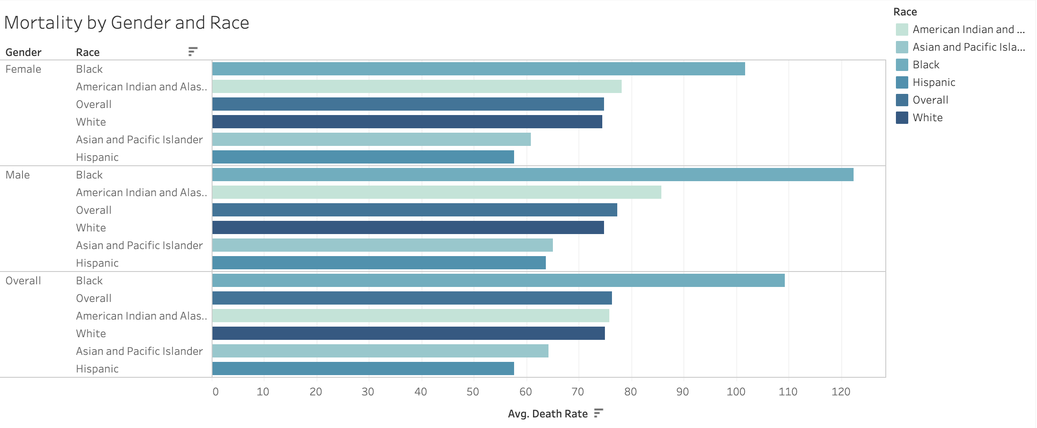
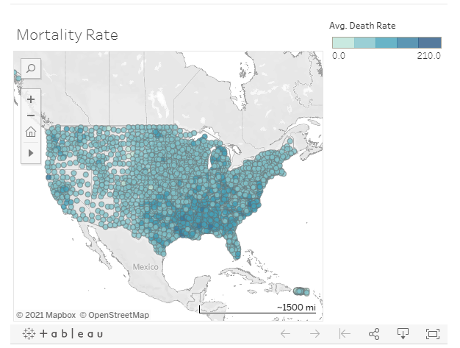
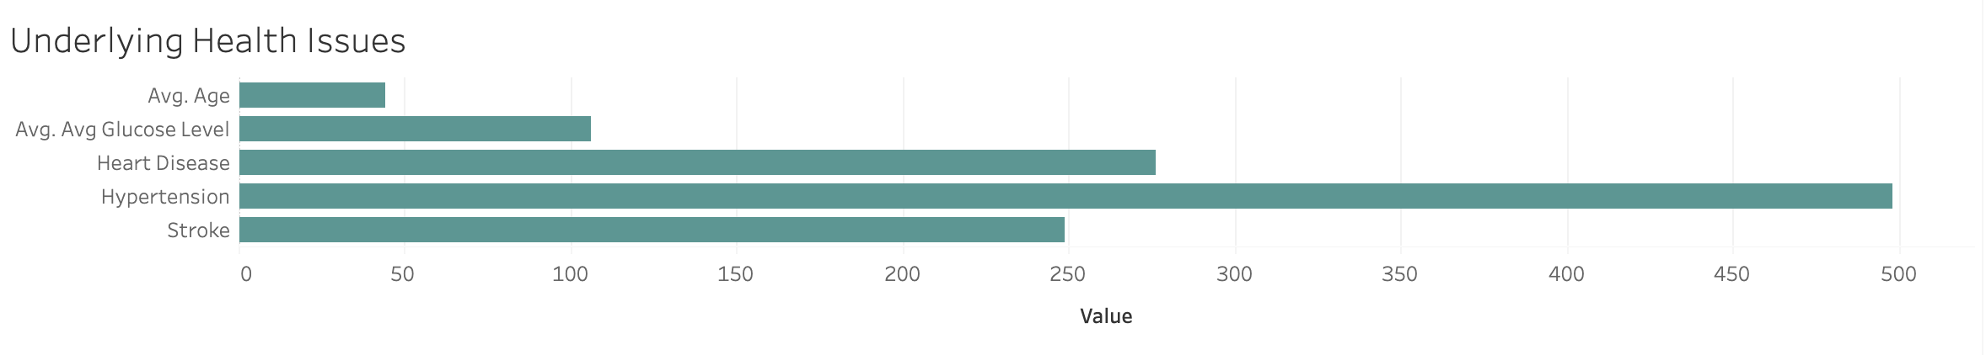
Tableau Visualizations
Interactive Tableau visualizations
Notes:
Hannah

Slide 11
<div class='tableauPlaceholder' id='viz1614909078082' style='position: relative'><noscript><a href='#'><img alt=' ' src='https:&#47;&#47;public.tableau.com&#47;static&#47;images&#47;St&#47;StrokeDeathRates&#47;MortalityRate&#47;1_rss.png' style='border: none' /></a></noscript><object class='tableauViz' style='display:none;'><param name='host_url' value='https%3A%2F%2Fpublic.tableau.com%2F' /> <param name='embed_code_version' value='3' /> <param name='site_root' value='' /><param name='name' value='StrokeDeathRates&#47;MortalityRate' /><param name='tabs' value='no' /><param name='toolbar' value='yes' /><param name='static_image' value='https:&#47;&#47;public.tableau.com&#47;static&#47;images&#47;St&#47;StrokeDeathRates&#47;MortalityRate&#47;1.png' /> <param name='animate_transition' value='yes' /><param name='display_static_image' value='yes' /><param name='display_spinner' value='yes' /><param name='display_overlay' value='yes' /><param name='display_count' value='yes' /><param name='language' value='en' /><param name='filter' value='publish=yes' /></object></div> <script type='text/javascript'> var divElement = document.getElementById('viz1614909078082'); var vizElement = divElement.getElementsByTagName('object')[0]; vizElement.style.width='100%';vizElement.style.height=(divElement.offsetWidth*0.75)+'px'; var scriptElement = document.createElement('script'); scriptElement.src = 'https://public.tableau.com/javascripts/api/viz_v1.js'; vizElement.parentNode.insertBefore(scriptElement, vizElement); </script>
Tableau Code
One line of HTML code:
Notes:
Michelle

Slide 12

Visualizations

Slide 13
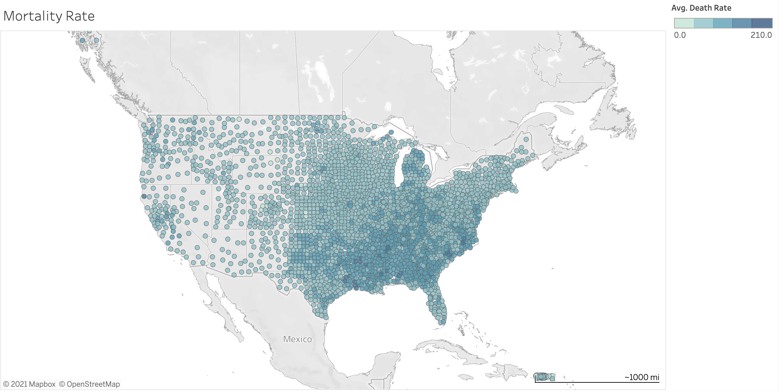
Geographical Factors
Notes:
Hannah
In tableau, we used latitude and longitude coordinates to create our US Map, which shows the average annual rate of stroke mortality per 100,000 people by county..
Our data from the CDC website was then used to create the circles on our map. The darker the circle, the higher the rate of mortality from a stroke.
There are 11 states in the south east that the CDC and other health officials call the “stroke belt”. As you all can see, in our data the south east is darker and has more darker dots that other areas of the map. So our data confirms these states to be more likely to have a deadly stroke than other locations throughout the country.

Slide 14
Gender & Race
Notes:
Ariel
Stroke mortality rates are also impacted by Gender and Race. In this tableau graph created from the CDC data, we see that there is not a huge difference between men and women, our overall is the combination of the two, and as you can see it is very similar to both. There is however a huge discrepancy when looking by race. Black individuals are much more likely to have a stroke than any other race. Black Males specifically have a much larger chance than any other gender race combination. On the other hand, hispanic individuals are the least likely to die from a stroke, specifically, hispanic females are the least likely gender race combination to have a deadly stroke.

Slide 15
Underlying Health Issues (Age, Glucose Levels, Heart Disease, Hypertension)
Notes:
Parker
There are many health factors that may cause someone to have a stroke.
As our kaggle data set shows us Heart Disease, Hypertension, and Average Glucose levels are just a few of the health factors we identified as being Stroke inducing.
You can see here that many adults in our study had hypertension, however, only half of those individuals resulted in have a stroke.
Heart Disease on the other hand, is almost equal to the amount of strokes--this is why our machine learning shows us that heart disease is the number one contributing factor in the probability of having a stroke.

Slide 16
Sociological Issues (Smoking, Residence Type, Marriage)
Notes:
Michelle
Finally, society also has a great impact on our lives. Any stress in our lives contribute to the probability of having a stroke and our kaggle data set was used to find that one of the highest contributing factors is if a patient has ever been married, it is more likely to cause a stroke if you have been married in the bar graph, the bars labelled Yes or No are depictions of marriage status.
The type of city you live in also contributes, here we have it broken down into Rural or Urban, in our data set, there are more strokes in an urban location than rural.
And our final contributor is Smoking status, which shockingly, this is the lowest impact issue we had in our data set; the likelihood of a stroke was spread out amongst all responses to smoking and these status’ are broken down by color in each bar of the graph.

Slide 17
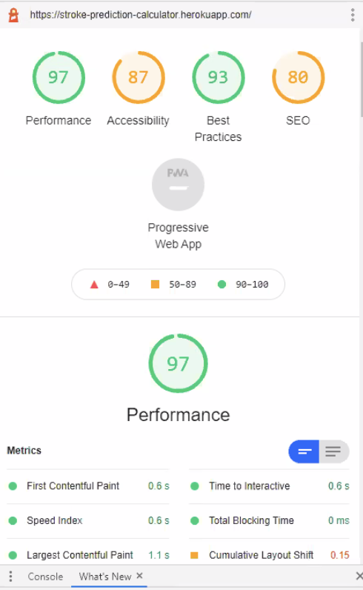
Deployment
Heroku to host the site
Google Lighthouse provided site analytics
Site customization with relevant
stroke related information
Notes:
Brandon
Heroku Deployment
Pip installs
Linked to Github

Slide 18

Considerations

Slide 19
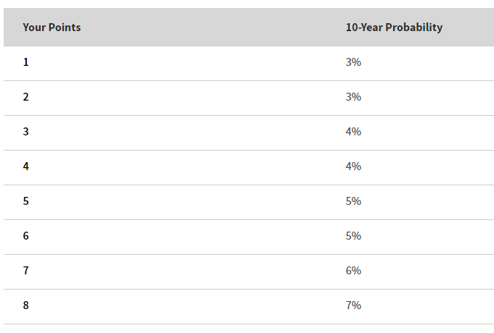
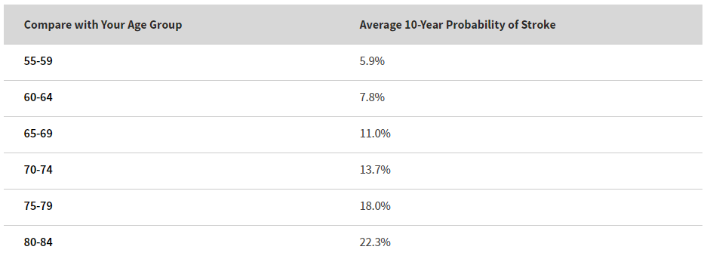
Considerations
If we had more time we would like to add in a graphic to display the Calculator results to compare your stroke risk to others in your age range
To ensure our results were accurate we found another online website calculator that confirmed our results
Calculator validation
https://www.ninds.nih.gov/Disorders/Patient-Caregiver-Education/Preventing-Stroke
Notes:
Ariel
Mobile friendly

